Slide 1

Siddaganga Institute of Technology, Tumakuru
Application of Text Classification and
Clustering of Twitter Data for Business Analytics
Presented By:
Anjali Choudhary 1SI15IS006
Department of Information Science and Engineering

Slide 2
Contents
Introduction to the Topic
Related Work
Design details
Technical Details
Applications
Limitations & Future work
Conclusion
References

Slide 3
Introduction
Social networks in business are gaining unprecedented popularity
Companies can use users sentiment to better understand the market and improve their brand.
Twitter data contains not only user information, but also texts that contain subjective information like sentiments towards a particular issue.
The wealth of tweets is enough for companies to gather sufficient feedback about their products and services from their customers.
This project mainly examines the use of sentiment analysis in business applications.

Slide 4
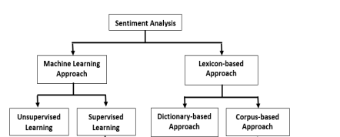
Related Work
Several studies have pointed out the importance and benefits of customer sentiment analysis for business operations.
Majority of the purposes are for business improvement and decision support.
Customer satisfaction is the key factor that influences decision making.
The success in extracting insights from the texts has allowed the company to provide an effective IT service management.
￼

Slide 5
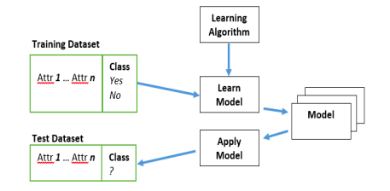
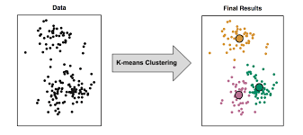
Design Details
Text Classification using a Decision Tree :
Text Clustering using a Decision Tree :
￼

Slide 6
Technical Details
The algorithm used for the project is Decision Tree and k- means clustering.
Decision Tree algorithm is described as:
The general motive of using Decision Tree is to create a training model which can use to predict class or value of target variables by learning decision rules inferred from prior data(training data).
The basic k-means algorithm is described as:
The K-means algorithm identifies k number of centroids, and then allocates every data point to the nearest cluster, while keeping the centroids as small as possible.
￼

Slide 7
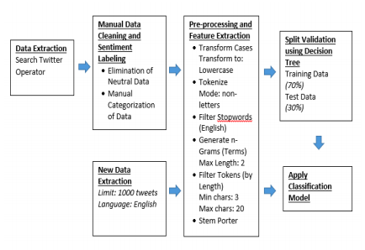
Technical Details
Text Classification process model

Slide 8
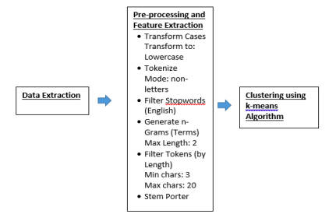
Technical Details
Text Clustering process model
￼

Slide 9
Applications
The outcome of evidence-based decision making contributes to the improvement of a brand.
Text analysis of customer feedback and reviews allows effective quality management.
Companies can now strategically reposition their businesses according to customers’ sentiments.
Practical implementation of text classification and clustering of Twitter data helps to gain business insights.

Slide 10
Limitations & Future work
The classification accuracy rate for this experiment is already acceptable in this application domain.
The future work needs to increase the accuracy of the classification model by improving data preparation and experimenting with other classification algorithms.
Future work in this field can also be focused on real- time analytics of Twitter data stream.
Since there is a massive amount of tweets collected daily, handling real-time analytics is difficult. Therefore an automated sentiment analysis, which runs in high processing and large memory computing resources is required.

Slide 11
Conclusion
The outcome of evidence-based decision making contributes to the improvement of a brand and helps in Business Analytics.
Having a text analysis of customer feedback and reviews allows effective quality management.
With sentiment analysis, companies can now strategically reposition their businesses according to customers’ sentiments.

Slide 12
References
[1] B. Liu, “Sentiment Analysis and Opinion Mining,” Synth. Lect. Hum. Lang. Technol., vol. 5, no. 1, pp. 1–167, 2012.
[2] V. A. Kharde and S. S. Sonawane, “Sentiment Analysis of Twitter Data: A Survey of Techniques,” Int. J. Comput. Appl., vol. 139, no. 11, pp. 975–8887, 2016.
[3] W. Medhat, A. Hassan, and H. Korashy, “Sentiment analysis algorithms and applications: A survey,” Ain Shams Eng. J., vol. 5, no. 4, pp. 1093– 1113, 2014.
[4] E. Alpaydin,IntroductiontoMachineLearning.2004.

Slide 13
Thank You

